Slide 2

EXAM FORMAT and OUTLINE OF COURSE CONTENT
ENGINEERING MACHINE LEARNING
HEALTH TECHNOLOGY

Slide 3

CENSOR
Carsten Eie Frigaard: https://pure.au.dk/portal/da/persons/carsten-eie-frigaard(38dc5072-5d5d-4bc0-9ddb-550674b8c14f).html

Slide 4
EXAM
Deliverables:
Email me presentation/pitch slides and if possible code (not data unless small) before the exam.
Optional:
Email me written text to prepare examiner/censor a week before exam.
Format: ~20min pitch as a group + ~30min questions as a group.
Grade based on group pitch and individual questions.
Pitch:
Builds on previous two pitches, but starts from the beginning.
Tell a coherent story, with motivation for each step.
Introduction and background, why is it interesting, what are the perspectives?
End-2-End machine learning project, as many steps as relevant.
What did you do, and why? Motivate choices, e.g. “we observed ‘this’ when we tried ‘that’, so then we tried ‘this’ because we hypothesized ‘that’..”
Results and perspectives – what could you do in the future, what could you have done instead.
Questions:
Initially open questions about the project, you decide who answers – if each of you don’t answer roughly the same number of questions we will point out who we want to answer.
Questions about other parts of the course that have not been covered already.

Slide 5
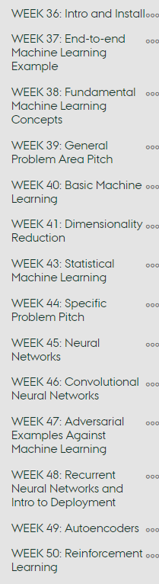
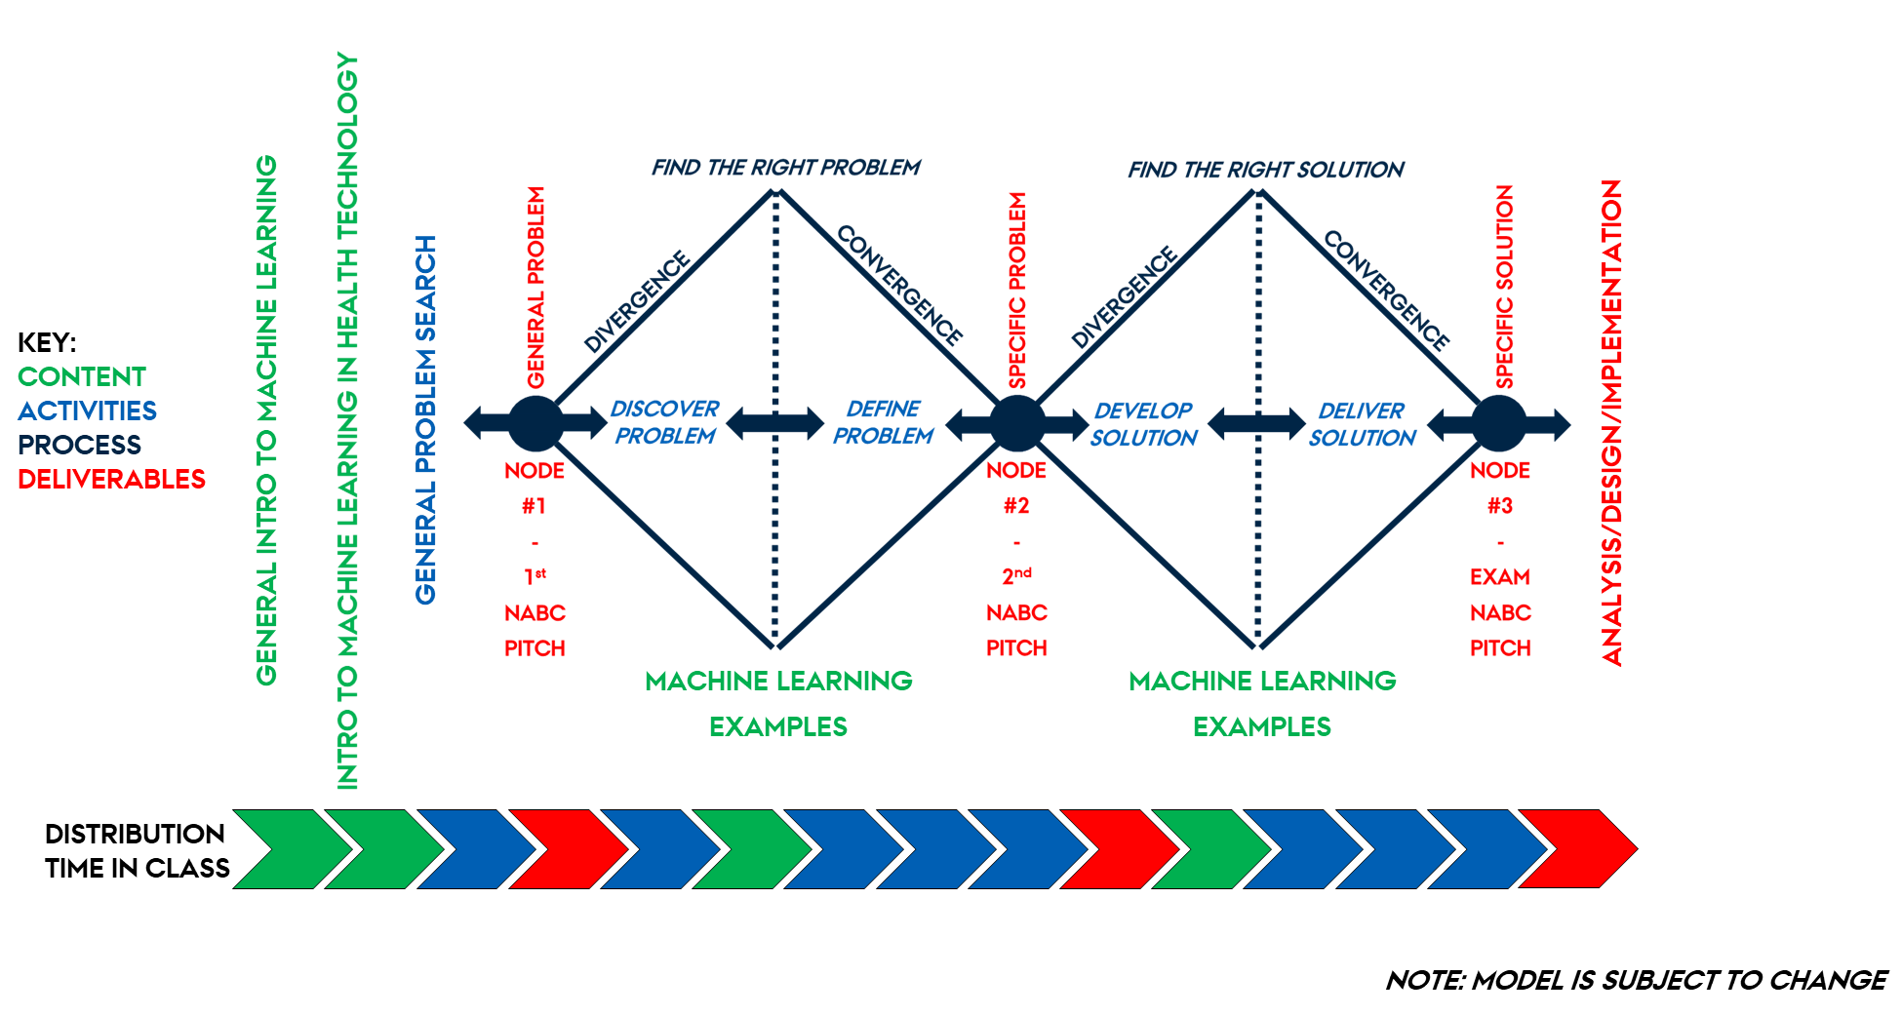
MACHINE LEARNING for Health tech

Slide 6


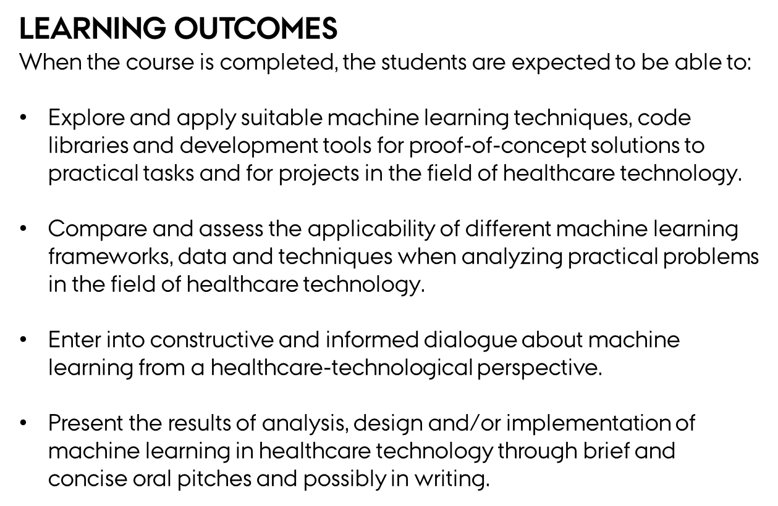
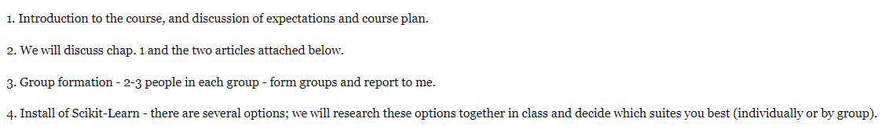


STTBML CONTENT

Slide 7
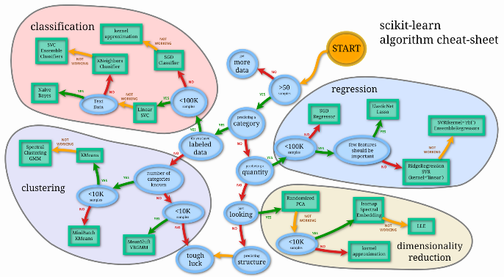


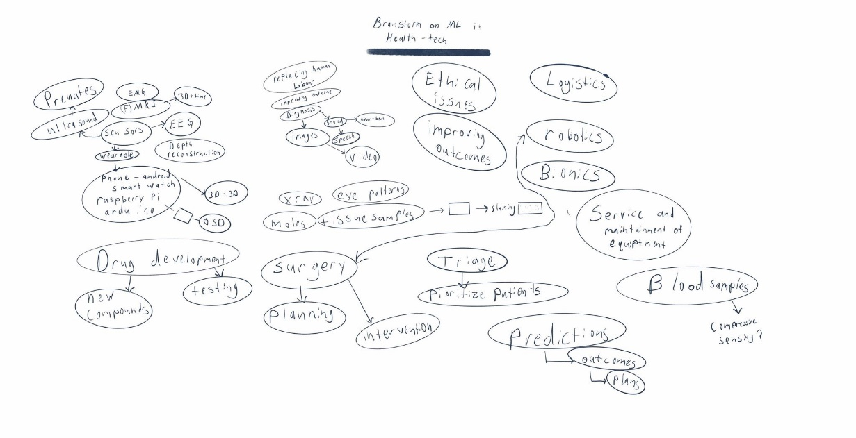

STTBML CONTENT

Slide 8
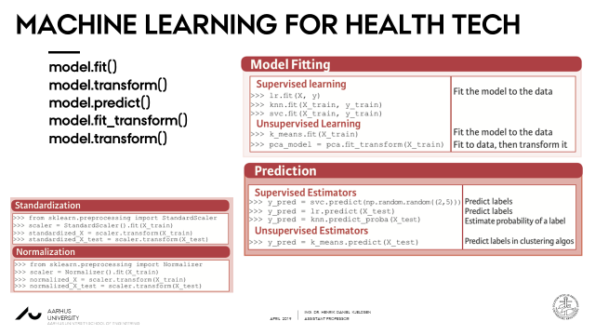

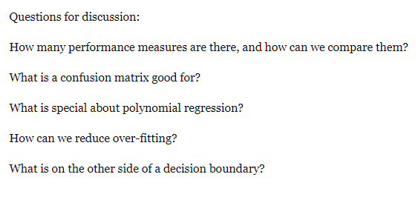
STTBML CONTENT

Slide 9

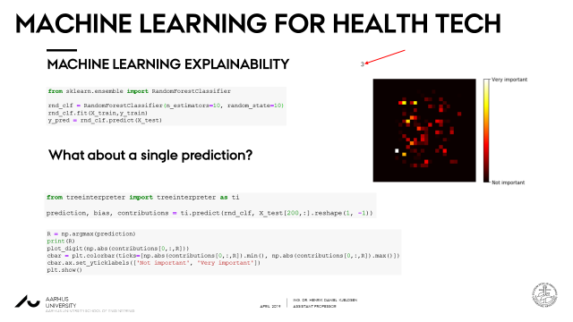

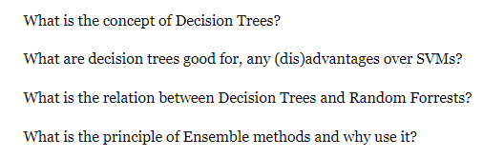
STTBML CONTENT

Slide 10
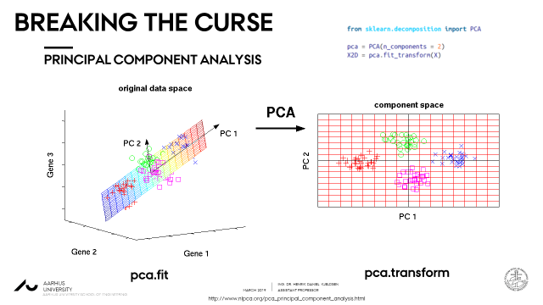

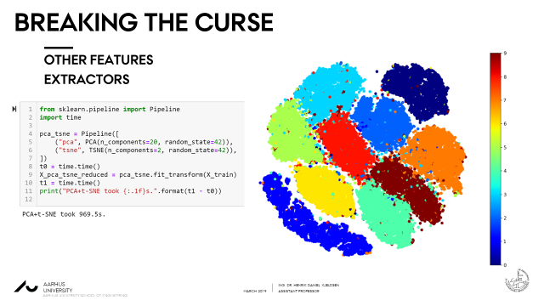
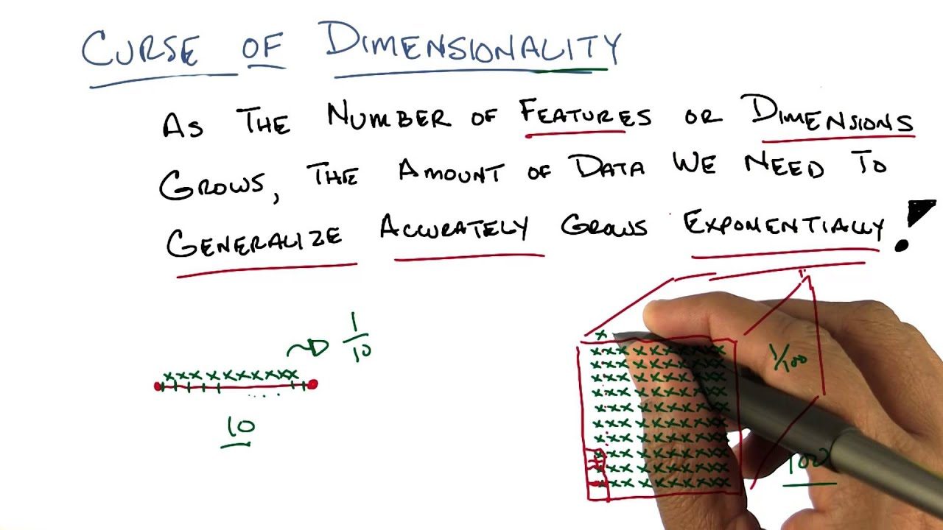
STTBML CONTENT

Slide 11
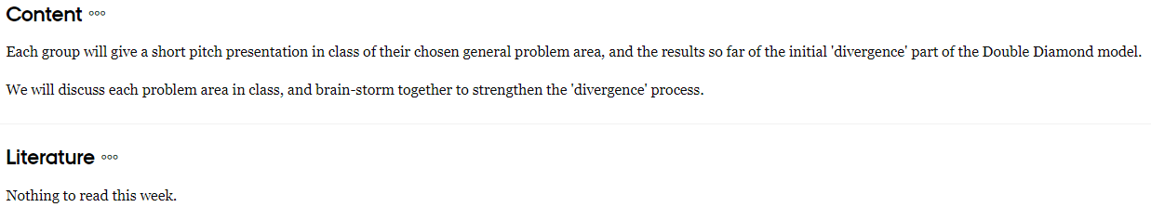
STTBML CONTENT

Slide 12


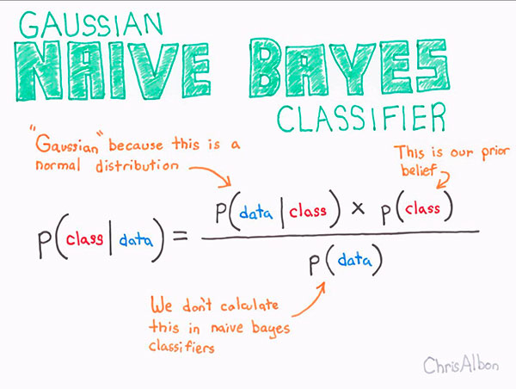
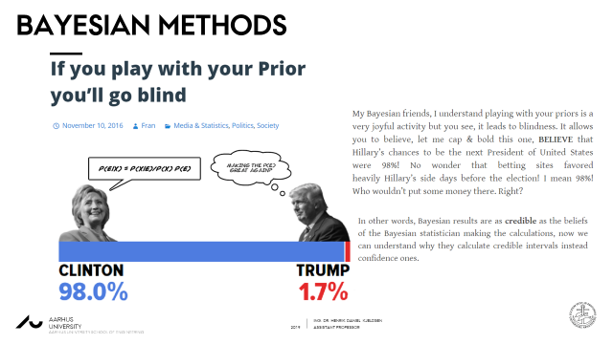
STTBML CONTENT

Slide 13
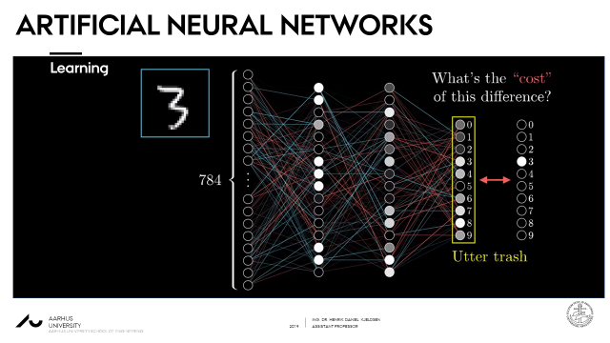

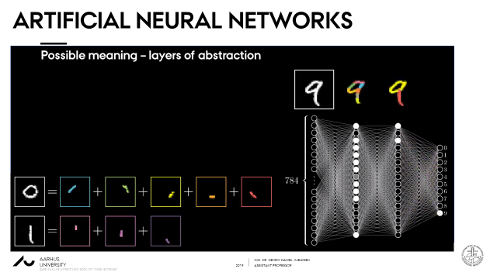
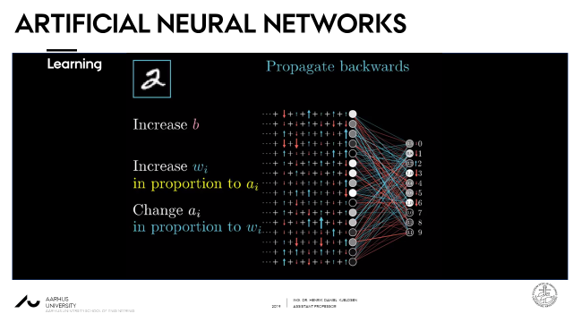
STTBML CONTENT

Slide 14


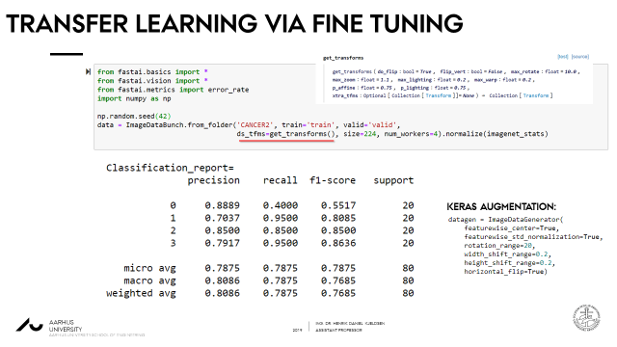
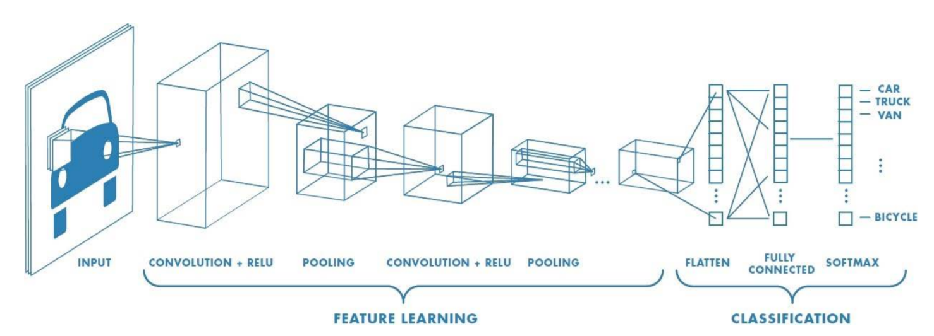
STTBML CONTENT

Slide 15
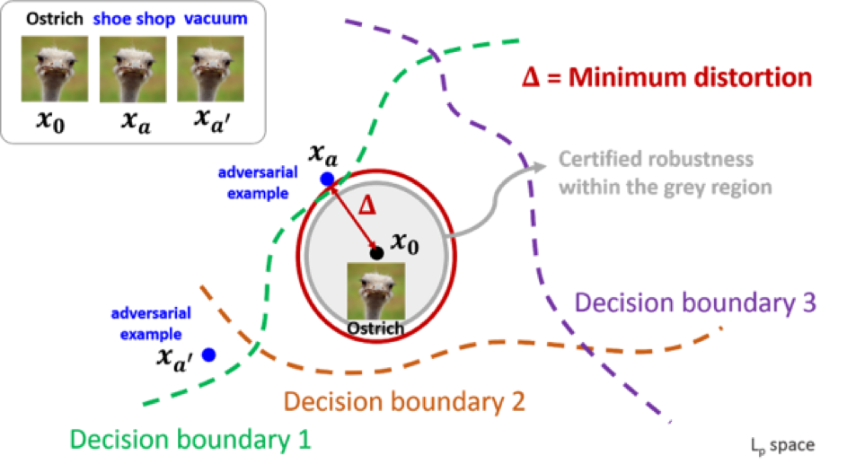

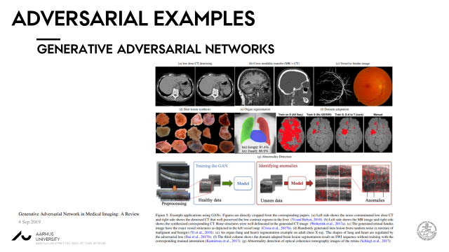

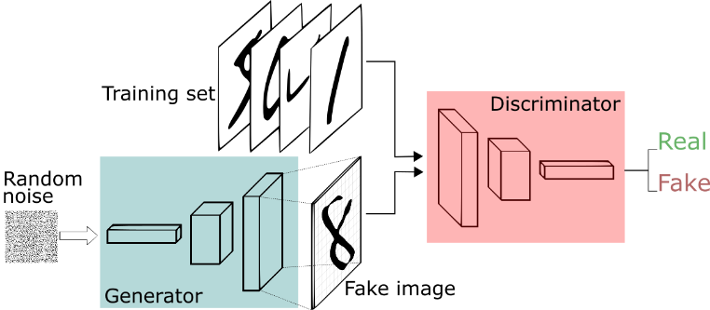
STTBML CONTENT

Slide 16
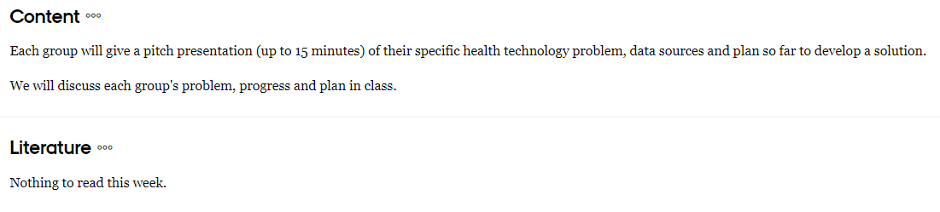
STTBML CONTENT

Slide 17
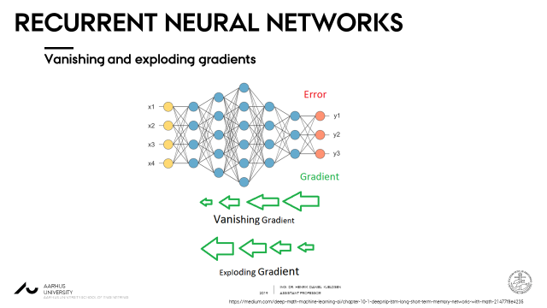

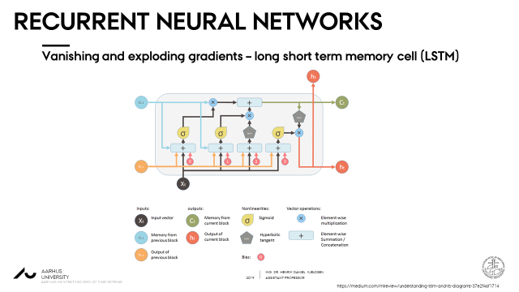

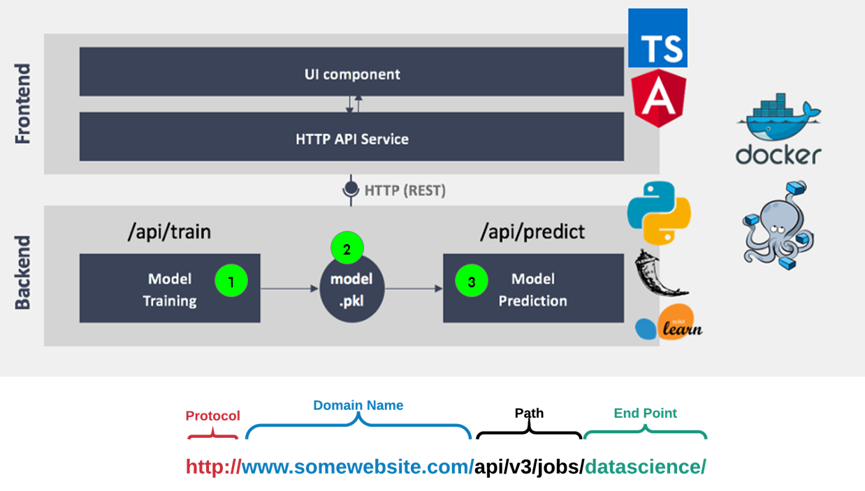
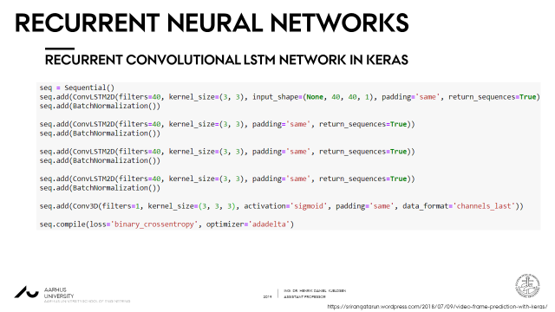
STTBML CONTENT

Slide 18

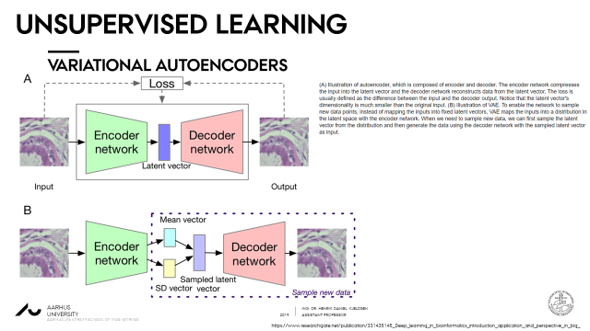
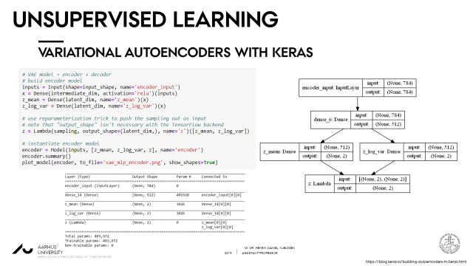

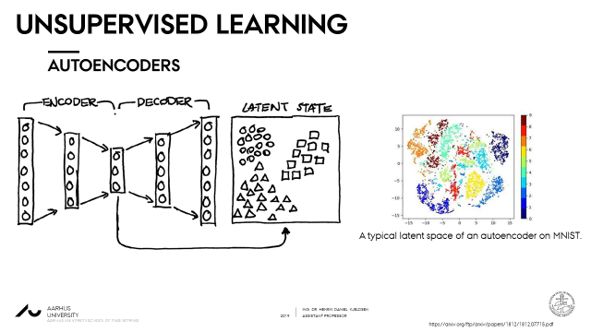
STTBML CONTENT

Slide 19
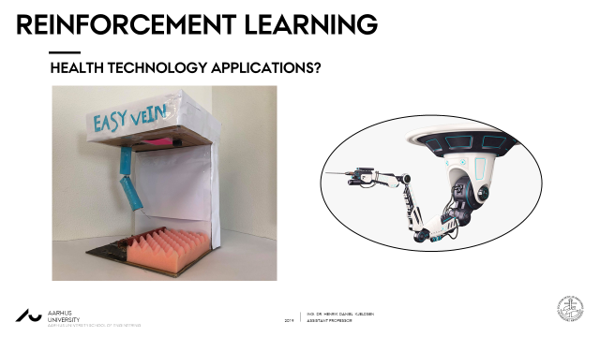

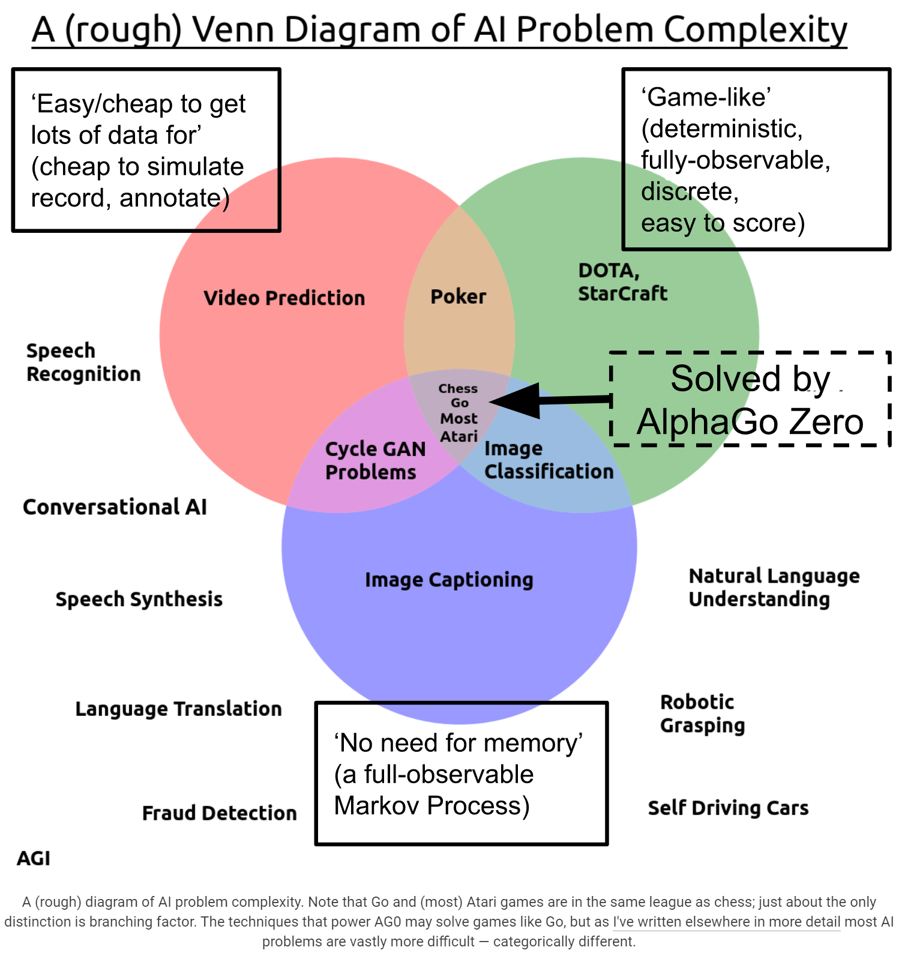

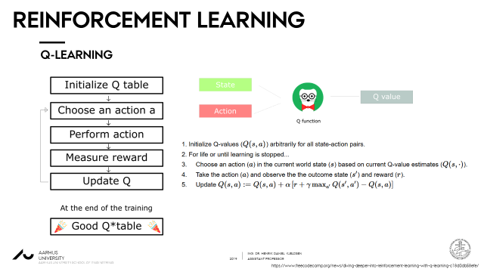
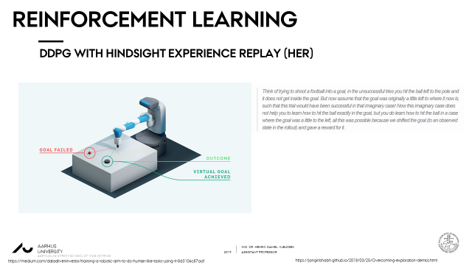
STTBML CONTENT

